Slide 1

Gender pay report
April 2020

Slide 2
Annual Gender Pay Reporting
Section title
What is the gender pay gap?
It is the difference between women’s and men’s average monthly (full time equivalent) earnings which is expressed a percentage of men’s earnings.
It is different to “equal pay” which looks at pay for men and women who perform the same role.
Why is NGN reporting on its gender pay gap?
Parliament introduced new legislation (Equality Act 2010 Regulations 2017) which requires large employers like ours to publish their Gender Pay information with effect from April 2019.
The report considers direct employees of NGN Limited and NGN Operations Limited. Our calculations follow the guidance set out in the Government legislation.
We commit to publish the report on our external website and on (https://www.gov.uk/report-gender-pay-gap-data ) where it will be available to upload for a period of 3 years.
1

Slide 3
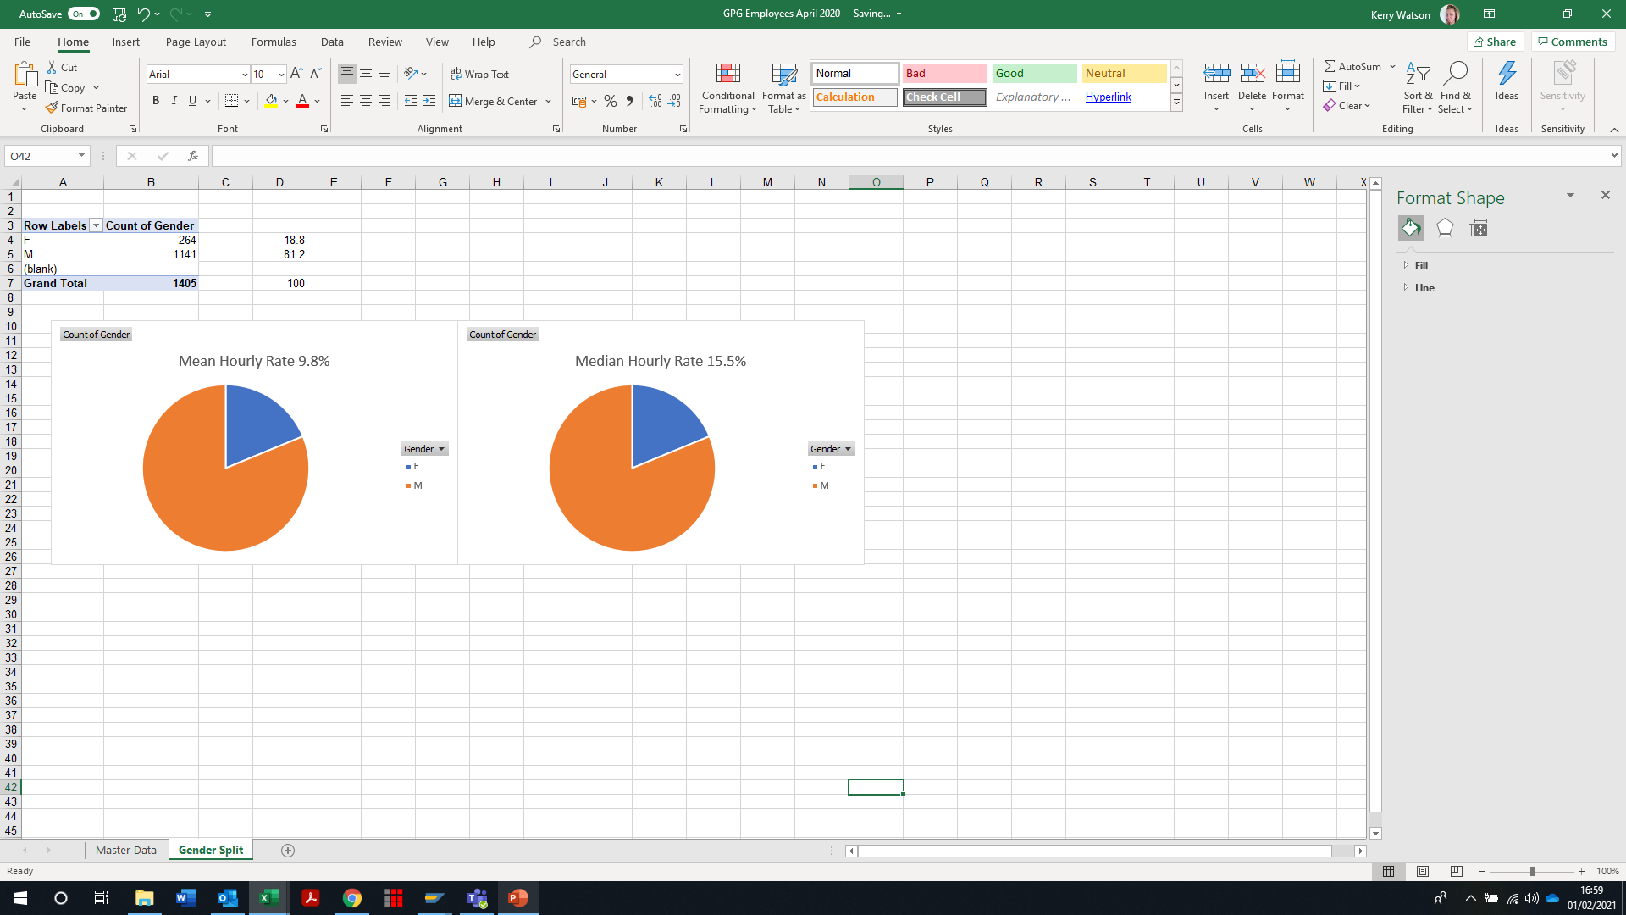
Report as at April 2020
Section title
Gender Pay Gap %
Percentage difference between male and female mean and median pay
for the period. Females make up 18.8% of the total workforce.
1
Notes:
April 2019 Mean = 9.3% and median = 14.7%

Slide 4
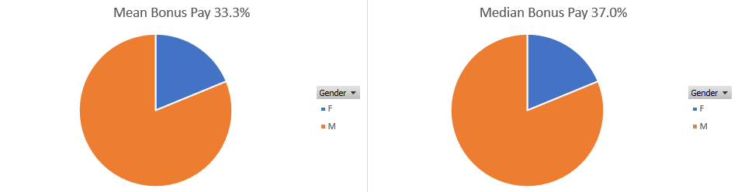
Report as at April 2020
Section title
Gender Bonus Gap %
Difference between male and female mean, and median bonus pay
for the period. 182 females and 797 males received bonus / incentive pay in the period.
1
Notes:
2019 figures = Mean = 30.5% Median = 19.7%

Slide 5
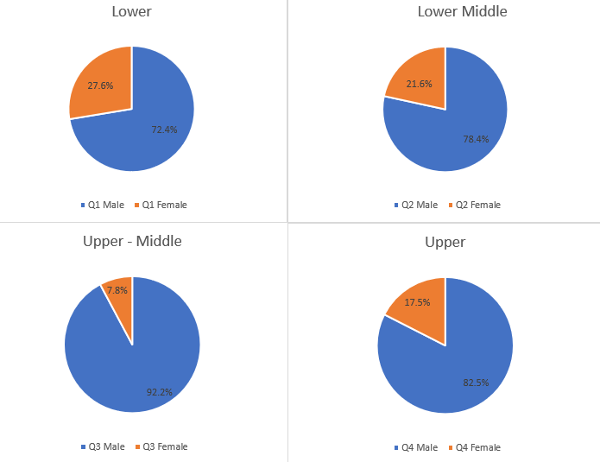
Report as at 5 April 2020
Quartiles %
Proportion of males and females across four equal size
quartiles for the pay period including 5 April 2020.
264 females and 1141 males total 1405 employees.
1

Slide 6
Our story …
Section title
Why do we have a gender pay gap?
The UK’s national gender pay gap is currently 15.5%. NGN’s figure is at 15.5%.
NGN's median Gender Pay Gap for 2020 is 15.5%. This is an increase from April 2019 which was reported at 14.7%.
Whilst we have a workforce made up of 81.2% men and 18.8% women, our business is typical of many others in engineering and has historically attracted a higher percentage of males.
Our analysis shows that there are significantly fewer women in the professional, engineering and senior management levels of the organisation. It is also widely acknowledged that there is a shortage of female students progressing into STEM subjects (Science, Technology, Engineering and Maths) through the formal education system, schools and universities/colleges.
How we are closing the gap?
Although our industry is traditionally perceived as a male dominated one, we are taking a range of actions to try and close the gender gap, and there is more to do. Work is being done through schools engagement to attract more women into our organisation. We have reviewed our recruitment practices and are utilising a system that reviews the language used in advertising to ensure there is no gender bias
In addition, we have engage with some alternative suppliers specifically in respect to our apprentices, which has resulted in our recruiting two female maintenance apprentices for the first time ever.
We continue to provide generous family friendly policies including paid keeping in touch days, six months full maternity pay, and a flexible working policy to encourage more women to join NGN and stay with us.
We have seen a small increase to our pay gap from 2019 which comes as a result of organisational changes.
1

Slide 7

Declaration
Section title
I confirm that the data contained in this report has been generated by NGN systems; checked and validated as accurate and fully audited.
Mark Horsley, CEO, Northern Gas Networks
Northern Gas Networks Limited
Registered Office No. 5167070
Thorpe Park Business Park, Colton, Leeds, LS15 8TU
www.northerngasnetworks.co.uk
1

