Slide 1

Gender pay report
April 2019

Slide 2
Annual Gender Pay Reporting
Section title
What is the gender pay gap?
It is the difference between women’s and men’s average monthly (full time equivalent) earnings which is expressed a percentage of men’s earnings.
It is different to “equal pay” which looks at pay for men and women who perform the same role.
Why is NGN reporting on its gender pay gap?
Parliament introduced new legislation (Equality Act 2010 Regulations 2017) which requires large employers like ours to publish their Gender Pay information with effect from April 2019.
The report considers direct employees of NGN Limited and NGN Operations Limited. Our calculations follow the guidance set out in the Government legislation.
We commit to publish the report on our external website and on (https://www.gov.uk/report-gender-pay-gap-data ) where it will be available to upload for a period of 3 years.
1

Slide 3
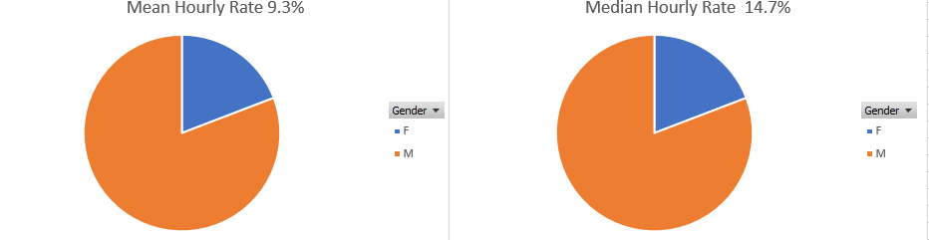
Report as at April 2019
Section title
Gender Pay Gap %
Percentage difference between male and female mean and median pay
for the period. Females make up 20.1% of the total workforce.
2
Notes:
April 2018 Mean = 7% and median = 11.9%

Slide 4
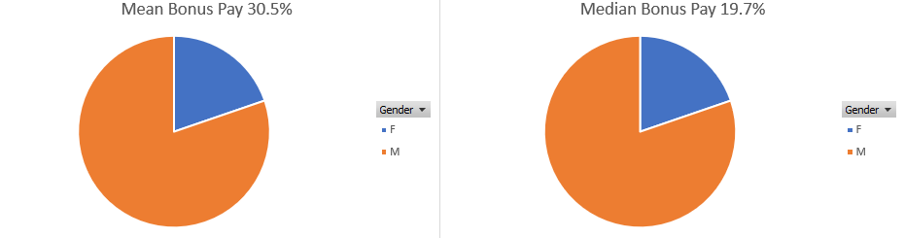
Report as at April 2019
Section title
Gender Bonus Gap %
Difference between male and female mean, and median bonus pay
for the period. 178 females and 724 males received bonus / incentive pay in the period.
3
Notes:
2018 figures = Mean = 42.5% Median = 39.4%

Slide 5
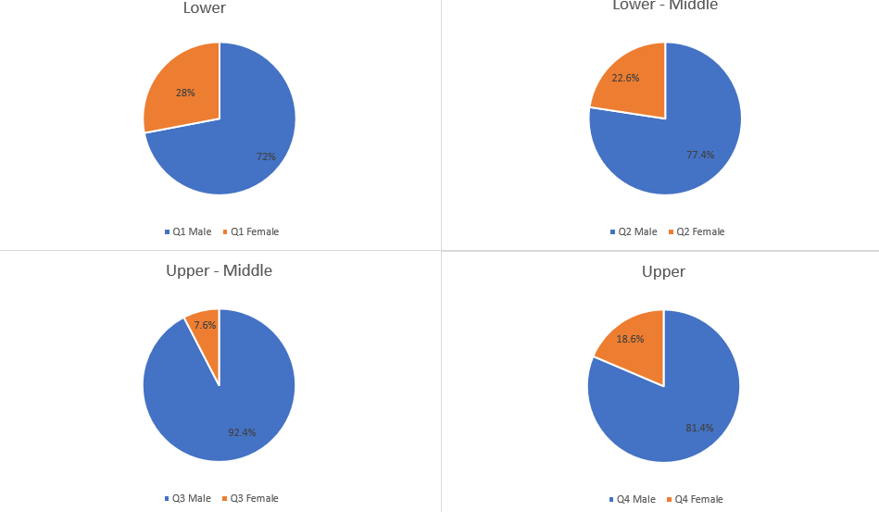
Report as at 5 April 2019
Quartiles %
Proportion of males and females across four equal size
quartiles for the pay period including 5 April 2019.
274 females and 1089 males total 1363 employees.
4

Slide 6
Our story …
Section title
Why do we have a gender pay gap?
The UK’s national gender pay gap is currently 17.3%. NGN compares well to this figure at 14.7%.
NGN's median Gender Pay Gap for 2019 is 14.7 %. This is an increase from April 2018 which was reported at 11.9%.
Whilst we have a workforce made up of 79.9% men and 20.1% women, our business is typical of many others in engineering and has historically attracted a higher percentage of males.
Our analysis shows that there are significantly fewer women in the professional, engineering and senior management levels of the organisation. It is also widely acknowledged that there is a shortage of female students progressing into STEM subjects (Science, Technology, Engineering and Maths) through the formal education system, schools and universities/colleges.
How we are closing the gap?
Although our industry is traditionally perceived as a male dominated one, we are taking a range of actions to try and close the gender gap, and there is more to do. Work is being done through schools' engagement to attract more women into our organisation. We are actively engaged with the Energy and Utility Skills Partnership and we have committed to driving our recruitment activities through their site. This site is designed to target non traditional audiences and attract a different range of potential candidates into our industry.
In addition, we have made changes to our advertising for operational recruits to encourage more women to apply.
We continue to provide generous family friendly policies including paid keeping in touch days, six months full maternity pay, and a flexible working policy to encourage more women to join NGN and stay with us.
We have seen an increase to our pay gap from 2018 which comes as a result of organisational changes, more recent senior appointments have resulted in more females being appointed and we fully anticipate seeing this increase revert to a decrease in our report next year.
5

Slide 7

Declaration
Section title
I confirm that the data contained in this report has been generated by NGN systems; checked and validated as accurate and fully audited.
Mark Horsley, CEO, Northern Gas Networks
Northern Gas Networks Limited
Registered Office No. 5167070
Thorpe Park Business Park, Colton, Leeds, LS15 8TU
www.northerngasnetworks.co.uk
6

